Slide 1

Image search app
Gurdit singh
Avinash
Jashan
Notes:
NOTE:
To change the image on this slide, select the picture and delete it. Then click the Pictures icon in the placeholder to insert your own image.

Slide 2


Solitaire Infosys Pvt. Ltd. Is An Acclaimed IT Service Provider Contributing Its Part In The Development Of Many Businesses Around The Globe. They Socialize With Their Clients To Get A Superior Cognizance Of Their Business And Requirements And Help Them In Fabricating Websites And Applications For Their Business. Founded In 2011 By A Dynamic Duo With The Same Aim And Zeal, They Have Come A Long Way In Satisfying Their Clients. They Are Serving Our Clients With The World-class Services For More Than Seven Years Now. The Clients Are Delivered With The Best IT Solutions After They Have Developed A Great Understanding Of Their Business And Requirements. Their Team Works On The Client Projects Like Its Own And That Is The Reason Why They Hold The Edge In The League. With Every Project That They Deliver, They Deliver Their Respect, Creativity, Quality, Transparency, And Teamwork To Their Clients. They Have The Experience, Expertise, And Capabilities To Enable Organizations To Accelerate Their Service Processes In Every Possible Way.

Slide 3
INTRODUCTION
Image Search Apps Have Revolutionized The Way We Discover And Interact With Visual Content. These Innovative Tools Utilize Advanced Algorithms And Artificial Intelligence To Analyze And Identify Images Based On User Queries, Enabling Seamless Exploration Of Vast Image Databases. Users Can Simply Upload A Photo Or Input Keywords To Find Similar Images, Products, Or Information Related To Their Search.
Moreover, Image Search Apps Enhance Creativity By Providing Users With Visual References For Projects, Art, Or Design. As Technology Continues To Advance, These Applications Will Likely Become Even More Intuitive, Making Image Discovery An Integral Part Of Our Digital Experience.

Slide 4
FEATURES OF APPLICATION
Categories and Collections: Organize images into categories (e.g., nature, technology, people) and curated collections for easy browsing.
User Accounts and Favorites: Enable users to create accounts to save favorite images, create collections, and track their downloads.
Upload Functionality: Allow users to upload their own images, contributing to the community and expanding the database.
Image Editing Tools: Integrate basic editing tools for users to adjust brightness, contrast, and apply filters directly within the app.

Slide 5
Related Images Suggestions: Provide suggestions for similar images based on user searches or viewed images to enhance discovery.
Download Options: Offer various download sizes and formats, ensuring images are available for different use cases.
Licensing Information: Clearly display licensing information for each image, ensuring users understand usage rights.
Community Features: Include options for commenting, liking, and sharing images, fostering a community around the content.
Mobile Optimization: Ensure the app is fully optimized for mobile devices, providing a seamless experience across platforms.
Tagging and Metadata: Use tags and metadata to enhance searchability and organization of images.

Slide 6
TECHNOLOGY
Creating An Image Search App Using A Full-stack Technology Approach Involves Both Frontend And Backend Development. Here’s A Brief Overview Of How You Can Structure This Project:
Frontend Development Technologies: html/CSS: For Structuring And Styling The Web Pages.
JavaScript Framework: Use Frameworks For Building Dynamic User Interfaces.
Components: Image Upload Form: A Component To Allow Users To Upload Images Along With Metadata (Like Tags And Descriptions).
Search Bar: A Search Component Where Users Can Input Keywords To Find Images.
Image Gallery: A Display Area For Showing Search Results, Including Thumbnails And Relevant Metadata.

Slide 7

Html: provides the structure of the music player interface .
Javascript: implements the functionality of the music player.
Application flow:
Initialization: the application loads with a default playlist and uI elements.
Play/pause: users can click the play button to start playback and pause to stop.
Next/previous: user can navigate through tracks using next and previous buttons.
Volume control: a volume slider adjusts the audio output volume.
Playlist management: user can add new tracks to the playlist and remove existing ones.

Slide 8
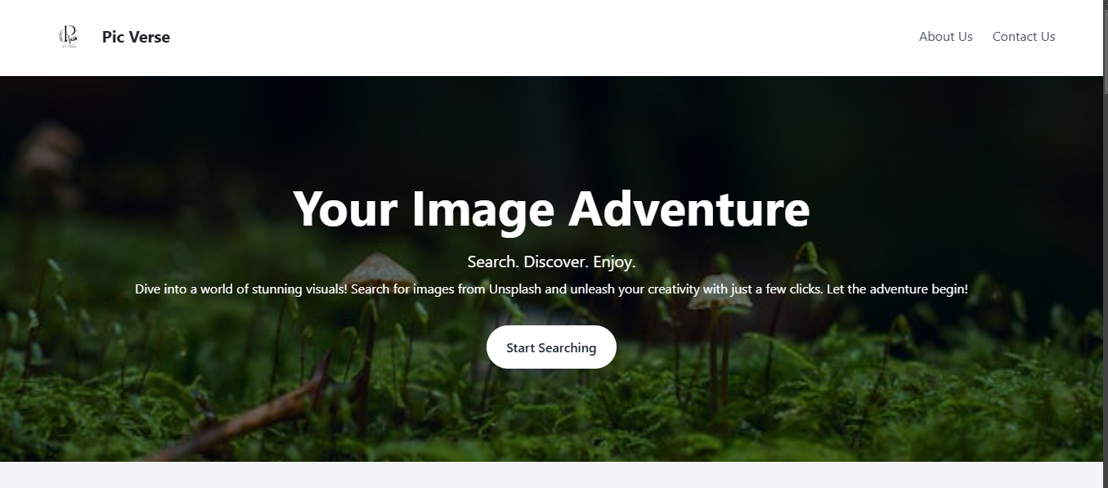
HOME PAGE

Slide 9
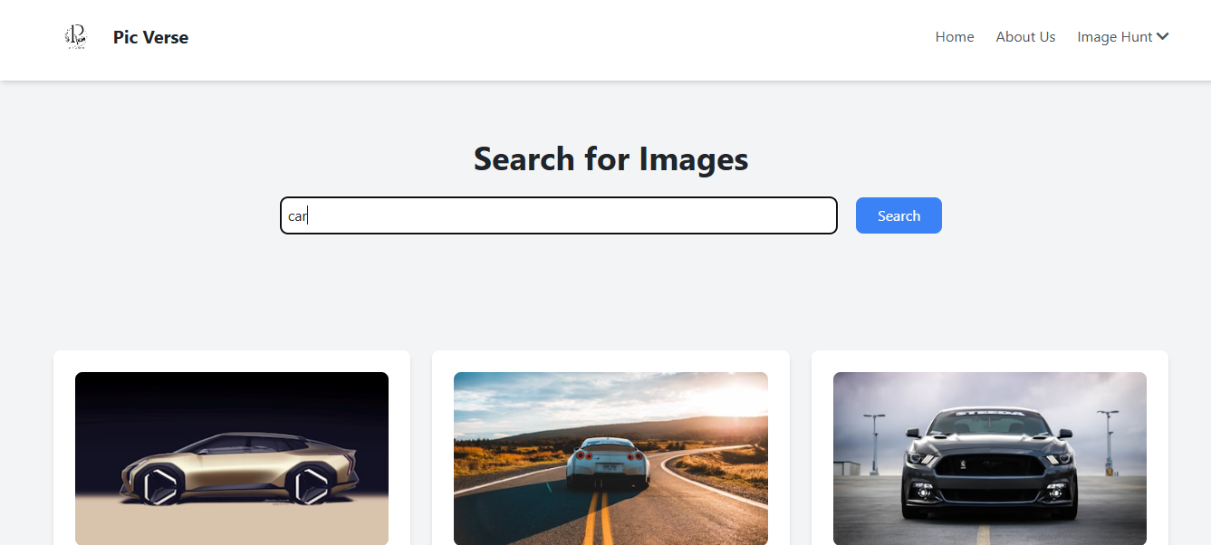
SEARCH PAGE

Slide 10
CONCLUSION
Image Search App Into Can Significantly Enhance User Experience And Engagement. Such A Feature Allows Visitors To Easily Find And Identify Images, Products, Or Related Content, Making Your Site More Interactive And User-friendly. By Leveraging Existing Technologies Custom Solutions, You Can Provide Valuable Tools That Cater To Your Audience's Needs. This Not Only Improves Accessibility But Also Encourages Users To Explore Further, Ultimately Driving Traffic And Increasing Satisfaction.

Slide 11
Thank you

